Slide 1
INVESTING IN HEALTH SYSTEMS: Insights into How Health Financing Shapes Workforce Density, UHC Service Coverage, and Key Health Outcomes. A WHO African Regional Perspective

Slide 2
Background
Health financing refers to how resources are raised, pooled, and spent to fund health services.
WHO standards emphasize on raising sufficient funds, pooling risks fairly, and purchasing services strategically to ensure people have access to quality care without financial hardship.
Most countries in Africa face challenges such as high out-of-pocket (OOP) spending, fragmented risk pools, underfunding of public health, and overreliance on donor funding.
Because after all, “Health financing is not just about spending more, but spending better and pooling risks fairly”.
In this research, we aimed to:
Identify the proportion of CHE components to achieve optimal key health outcomes.
Determine the optimal number of doctors, nurses, midwives, pharmacists, and dentists to achieve improved key health outcomes.
Compute the amount of government expenditure on health required to achieve the optimal level of health workforce density.
Historical data from 2000-2024 for the 47 WHO African regional countries was used for this analysis.
Key health outcomes such as life expectancy (LE), maternal mortality (MMR), infant mortality (IMR), and UHC service coverage index (SCI) were considered in the optimization problems.

Slide 3
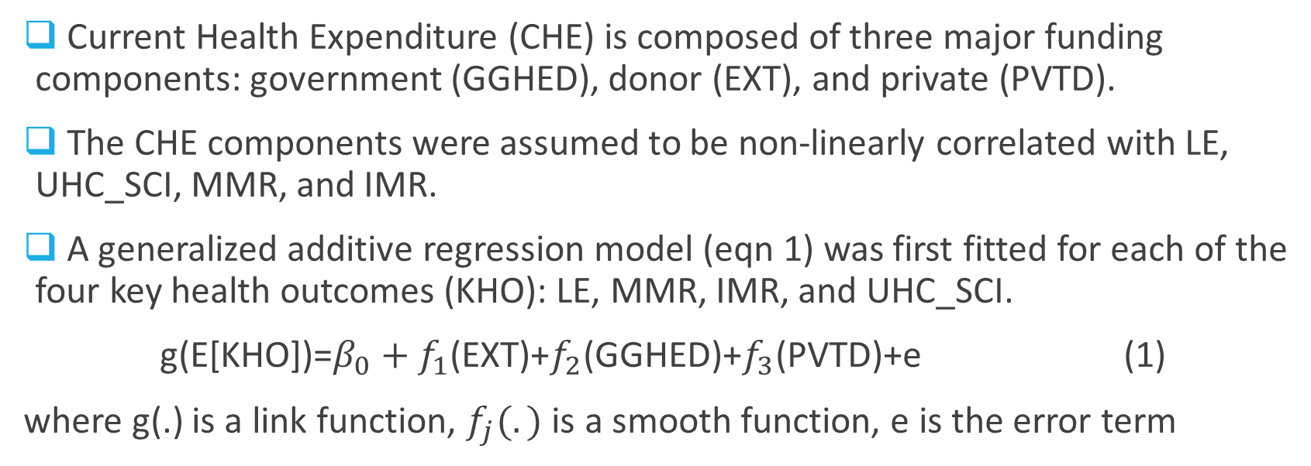
Effect of CHE components on Key Health Outcomes
Current Health Expenditure (CHE) is composed of three major funding components: government (GGHED), donor (EXT), and private (PVTD).
The CHE components were assumed to be non-linearly correlated with LE, UHC_SCI, MMR, and IMR.
A generalized additive regression model (eqn 1) was first fitted for each of the four key health outcomes (KHO): LE, MMR, IMR, and UHC_SCI.
g(E[KHO])=$β_{0}+f_{1}$(EXT)+$f_{2}$(GGHED)+$f_{3}$(PVTD)+e (1)
where g(.) is a link function, $f_{j}(.)$ is a smooth function, e is the error term

Slide 4
Effect of CHE components on Key Health Outcomes and Service Coverage Index contd…
The results of the GAM model were as summarized in Table 1.
On average, GGHED has the most significant effect on all health outcomes: LE, MMR, and IMR.
EXT has the second-highest effect on LE and IMR.
PVTD has the second-highest effect on LE and MMR.
UHC_SCI is influenced by EXT followed by GGHED.
Table 1: Fitted GAM Results
Key Health Variable | EXT | GGHED | PVTD | Deviance Explained (%)
Life Expectancy (LE) | 6.447*** | 7.975*** | 5.440*** | 30.2
Maternal Mortality Ratio (MMR) | 3.839*** | 8.692*** | 8.130*** | 40.3
Infant Mortality Rate (IMR) | 5.363*** | 8.565*** | 3.620*** | 42.2
Universal Health Coverage (UHC_SCI) | 7.769*** | 6.960*** | 6.617*** | 73.1
Sig. codes: ***<0.001, **<0.01, *<0.05

Slide 5
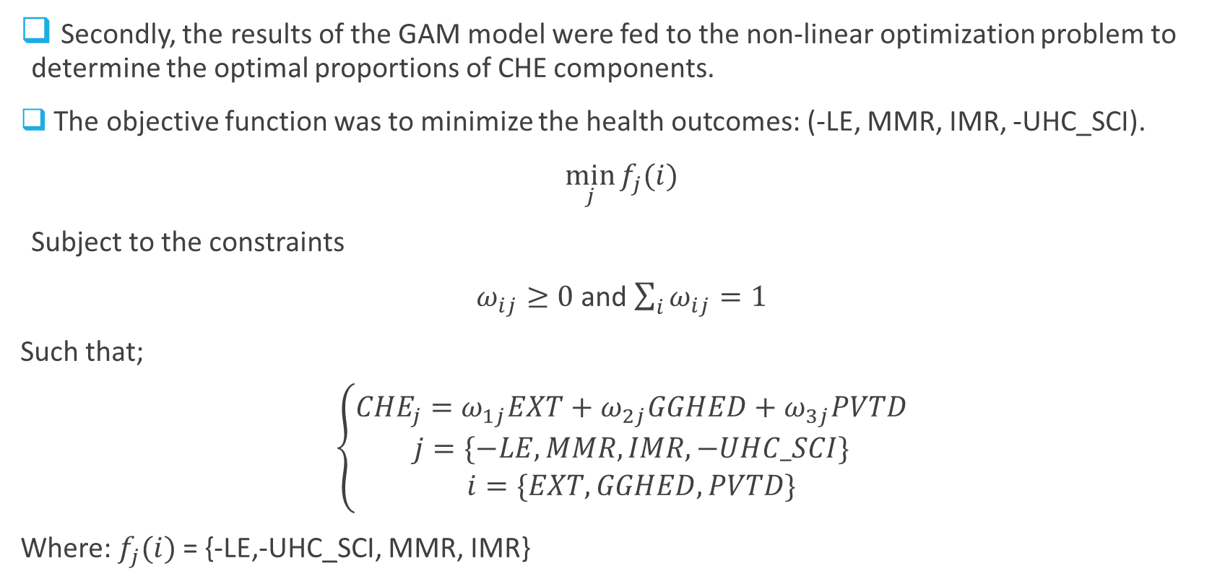
Optimal Allocation of CHE Components
Secondly, the results of the GAM model were fed to the non-linear optimization problem to determine the optimal proportions of CHE components.
The objective function was to minimize the health outcomes: (-LE, MMR, IMR, -UHC_SCI).
$\min_{j}{f_{j}(i)}$
Subject to the constraints
$ω_{ij}≥0$ and $\sum_{i}{ω_{ij}}=1$
Such that;
$\left\{\begin{aligned}{CHE}_{j}=ω_{1j}EXT+ω_{2j}GGHED+ω_{3j}PVTD \\ j=\{−LE, MMR, IMR, −UHC_SCI\} \\ i=\{EXT, GGHED, PVTD\}\end{aligned}\right.$
Where: $f_{j}(i)$= {-LE,-UHC_SCI, MMR, IMR}

Slide 6
CHE Components Optimal Level Results
Table 2 below show the optimal allocation of CHE funding that improves the different health outcomes.
To obtain great health outcomes, governments should be encouraged to contribute 67% of CHE, private sources 19% of CHE, and the remaining 14% of CHE to be funded by external donor funding.
Table 2: Optimal Current Health Expenditure (CHE) Allocation Proportions (%)
Key Health Variable (j) | EXT (i=1) | GGHED (i=2) | PVTD (i=3)
Life Expectancy (LE) | 13.76 | 50.05 | 36.19
Maternal Mortality Ratio (MMR) | 7.71 | 92.29 | 0.00
Infant Mortality Rate (IMR) | 16.68 | 43.95 | 39.37
Universal Health Coverage (UHC_SCI) | 17.98 | 82.02 | 0.00
Averages | 14.03 | 67.08 | 18.89

Slide 7
Effect of 67% Government Expenditure on Health
Table 3 shows the effect of investing more than 67% of CHE.
Average health outcomes of countries recording 67% of CHE or more were compared to those recording less than 67% of CHE towards their GGHED.
Table 3 results show that for governments investing in >=67% of CHE, their:
Universal Health Service coverage index is higher by 26%.
Life expectancy is higher by 12.5 years.
Maternal mortality ratios decrease by 414.5 deaths per 100,000 live births
Infant Mortality ratios decrease by 34 deaths per 1,000 live births
Table 3: Impact of Government Health Expenditure on Health Outcomes
Key Health Variable | SCI_UHC | LE | MMR | IMR
GGHED<=67% of CHE | 39.3 | 59.3 | 496.0 | 58.0
GGHED>67% of CHE | 65.3 | 71.8 | 81.5 | 24.0

Slide 8
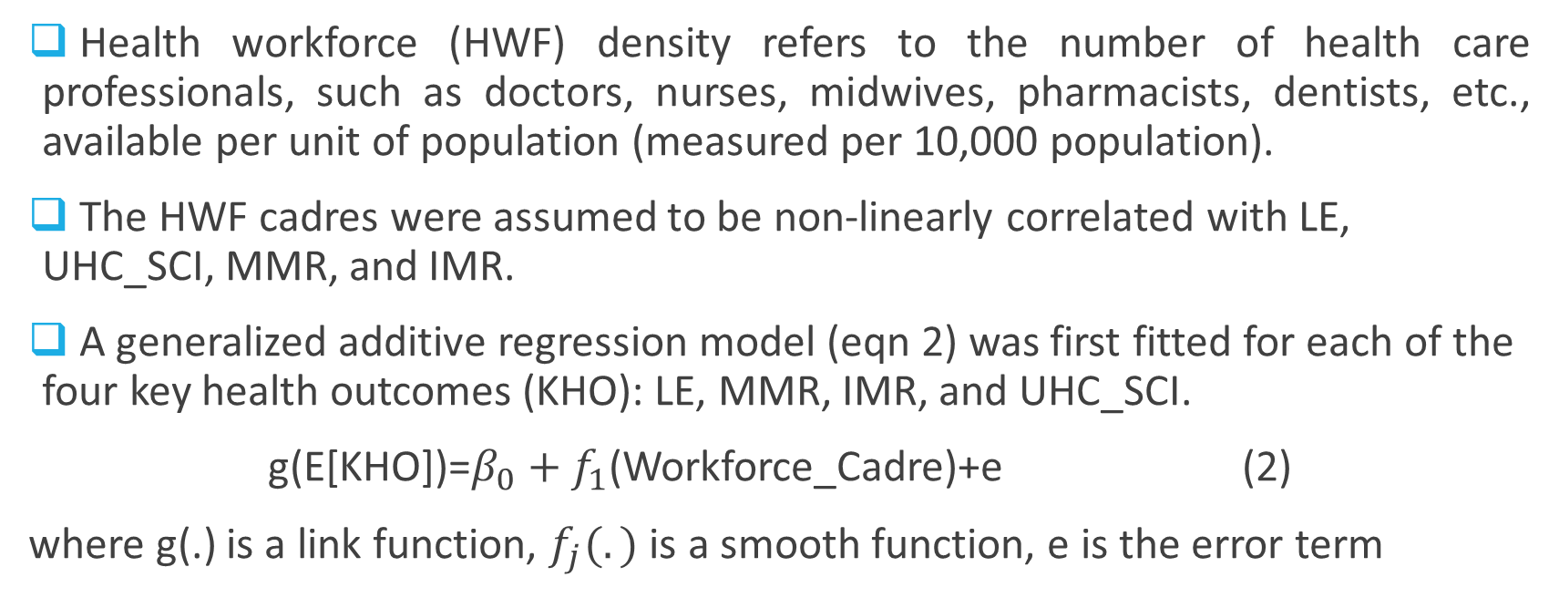
Effect of Key HWF Cadres on Key Health Outcomes
Health workforce (HWF) density refers to the number of health care professionals, such as doctors, nurses, midwives, pharmacists, dentists, etc., available per unit of population (measured per 10,000 population).
The HWF cadres were assumed to be non-linearly correlated with LE, UHC_SCI, MMR, and IMR.
A generalized additive regression model (eqn 2) was first fitted for each of the four key health outcomes (KHO): LE, MMR, IMR, and UHC_SCI.
g(E[KHO])=$β_{0}+f_{1}$(Workforce_Cadre)+e (2)
where g(.) is a link function, $f_{j}(.)$ is a smooth function, e is the error term

Slide 9
Optimal Health Workforce Density Level Results
Table 4 below show the optimal allocation of CHE funding that improves the different health outcomes.
To obtain improved health outcomes, countries need (22-32) doctors, (46-61) nurses and midwives, (3-4) dentists, and (8-11) pharmacists per 10,000 population.
Leading to a total of around 78-89 key health workers across the 5 cadres.
 | Table 4: Optimal Health Workforce Density Thresholds per 10,000 population Required for Key Health Outcomes
Key Health Variable |  | Doctors | Nurses & Midwives | Dentists | Pharmacists | Total
Life Expectancy (LE) |  | 30.52 | 29.25 | 2.57 | 5.15 | 67.49
Maternal Mortality Ratio (MMR) |  | 11.96 | 60.91 | 2.17 | 10.08 | 85.12
Infant Mortality Rate (IMR) |  | 31.61 | 46.35 | 2.85 | 7.96 | 88.77
Universal Health Coverage (UHC_SCI) |  | 12.69 | 47.44 | 3.16 | 7.88 | 71.17
Averages |  | 21.70 | 45.99 | 2.69 | 7.77 | 78.15

Slide 10
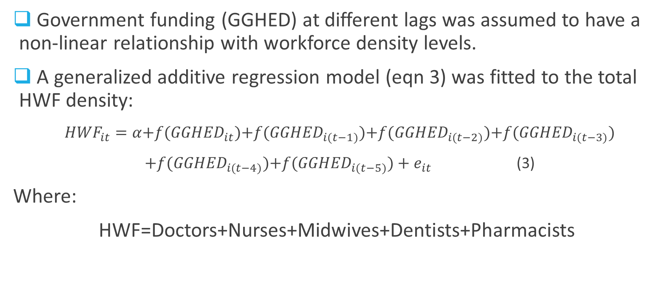
Effect of Government Financing on HWF Density
Government funding (GGHED) at different lags was assumed to have a non-linear relationship with workforce density levels.
A generalized additive regression model (eqn 3) was fitted to the total HWF density:
${HWF}_{it}=α{+f(GGHED}_{it}){+f(GGHED}_{i(t−1)}){+f(GGHED}_{i(t−2)}){+f(GGHED}_{i(t−3)})$
${+f(GGHED}_{i(t−4)}){+f(GGHED}_{i(t−5)})+e_{it}$ (3)
Where:
HWF=Doctors+Nurses+Midwives+Dentists+Pharmacists

Slide 11
Lagged GAM Model Results
The fitted GAM model result smooth parameter estimates were as shown:
Current and 5-year GGHED expenditures are only significant lags.
The 5-year GGHED lag had the most significant effect on HWF density, suggesting that health financing has a delayed effect on workforce growth through other constraints such as training, retention, etc.
edf>>1 implying that there is a non-linear effect of GGHED on HWF, implying there might be different thresholds depicting a possibility of diminishing returns.
Table 5: Lagged GAM Model Results on the effect of GGHED per capita on HWF
Variable | edf | Ref.df | F-value | pvalue
f(GGHED_Lag0) | 8.174 | 8.745 | 3.716 | 0.0002
f(GGHED_Lag1) | 1.000 | 1.000 | 0.156 | 0.6930
f(GGHED_Lag2) | 1.433 | 1.769 | 0.735 | 0.5703
f(GGHED_Lag3) | 1.000 | 1.000 | 2.746 | 0.0989
f(GGHED_Lag4) | 6.419 | 7.558 | 1.669 | 0.1299
f(GGHED_Lag5) | 8.203 | 8.762 | 4.383 | 0.0000

Slide 12
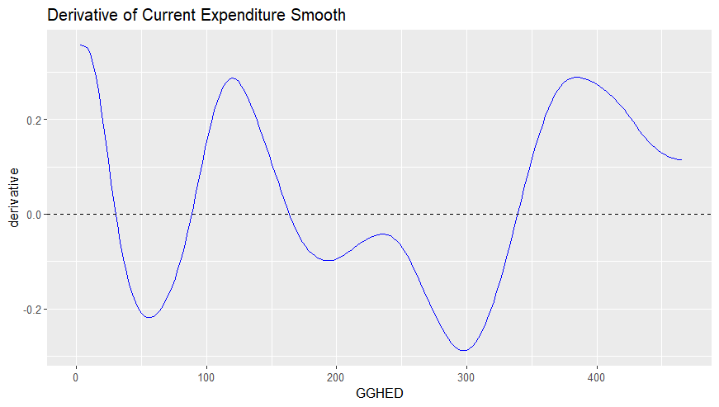
Current Govt Health Financing Thresholds on HWF Density
The results of the GAM model were fitted to the threshold regression model independently for the current and 5-year lag GGHED.
At current GGHED levels, thresholds where the sign of the derivative changes occur at $29, $87, $162, and $ 137 per capita.
This shows that there are alternating phases of growth and decline as spending increases.
Implying that more current spending on health doesn’t guarantee more workforce density.
Table 6: GGHED Threshold on HWF
GGHED per capita, $ | Derivative
29 | 0.0211
87 | -0.0144
162 | 0.0106
337 | -0.0226

Slide 13
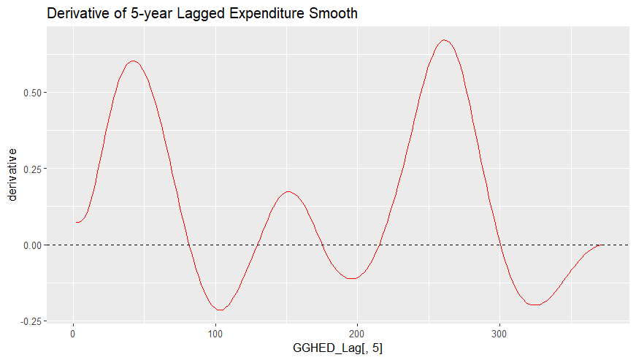
5- Year Lagged Govt Health Financing Thresholds on HWF Density
The 5-Year GGHED lagged levels thresholds where the sign of the derivative changes occur at $81, $129, $174, $214 and $300 per capita.
This shows that even with delayed effect, there are still alternating phases of growth and decline as spending increases.
Implying that more current spending on health doesn’t guarantee more workforce density 5 years into the future unless efficiency and optimal allocation levels are maintained.
Table 7: Five-Year Lagged GGHED Threshold on HWF
GGHED per capita, $ | Derivative
81 | 0.0117
129 | -0.0005
174 | 0.0066
214 | -0.0167
300 | 0.0107

Slide 14
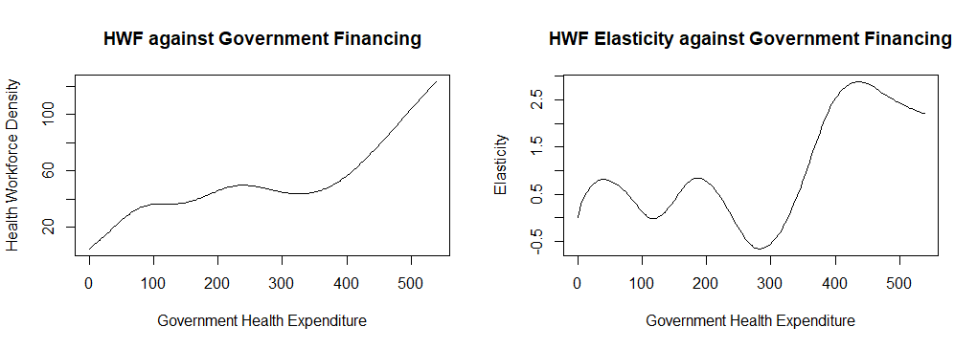
Health Workforce Elasticity vs Government Financing
The threshold regression model results were subjected to elasticity analysis.
Elasticity measures the % change HWF gets for a % increase in GGHED.
HWF density non-linearly increase with GGHED.
HWF elasticity levels increase and decrease at different levels of GGHED.
Optimal GGHED levels per capita recorded at $40.75, $186.83, and $438.41, responding 21.12, 43.46, and 72.88 health workers (doctors, nurses, midwives, pharmacists and dentists), respectively, per 10,000 population.
To achieve the recommended 78.16 HWF, invest $449.23 GGHED per capita.

